Slide 1


Release walkthrough
2026.2

Slide 2
Table of contents
Source Products
  Extend Product Module
  Import Products via Excel
  MA Number matching
Integrations
  Veeva Sync
  3rd party integration
Target Products
  Extend Target Module
  New Product Insight
  Remove IS, LI, NO Products from CAPs
Comparison

Slide 3
Source Products

Slide 4
Extend Source Product Module

Slide 5
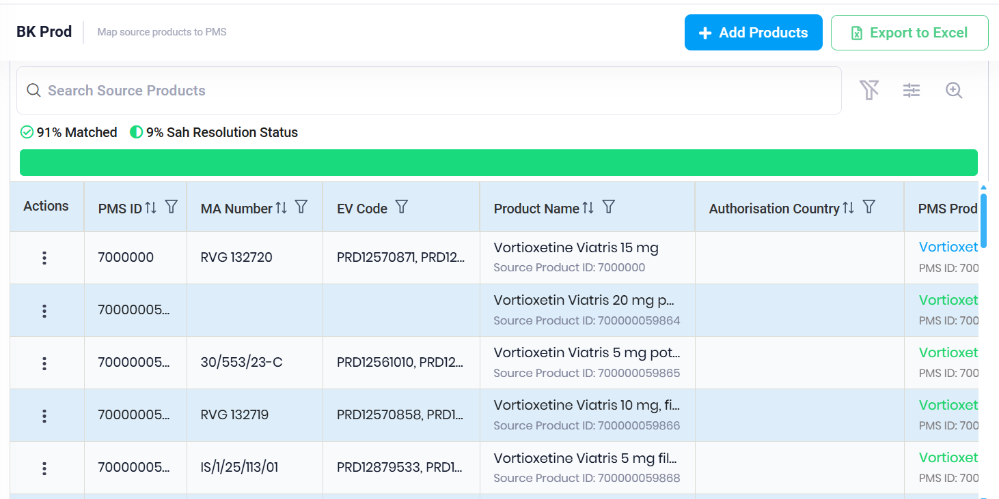
SPRFY-4651: Extend Product Module to Contain Source ID, Country, and MA Number: Source Products
Change Description:
The Product module in SPORIFY has been expanded to display the product's Source ID, Country, and MA Number for Source Products

Slide 6
SPRFY-5053: Filter/Search in Product Module for Source ID, Country and MA Number
In the Product module, users can now:
utilise the global search function for Source ID, MA Country, and MA Number.
filter products by Source ID, MA Country, and MA Number too. (the new table columns are sortable and filterable)
add or remove the new columns via the Preferences fly-out menu.

Slide 7
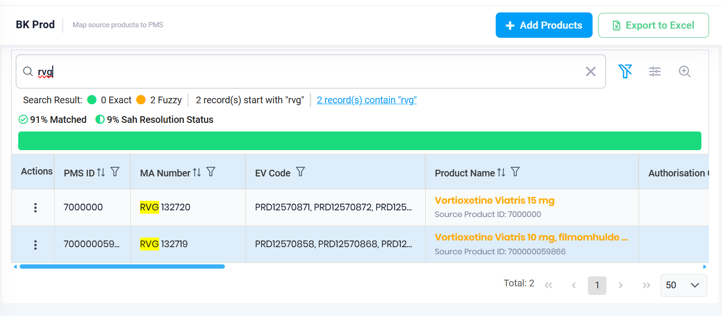
SPRFY-5053: Filter/Search in Product Module for Source ID, Country and MA Number

Slide 8
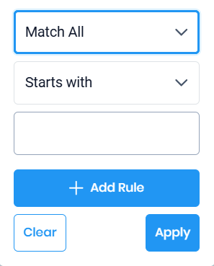
SPRFY-4651: Extend Product Module to Contain Source ID, Country, and MA Number: Source Products

Slide 9
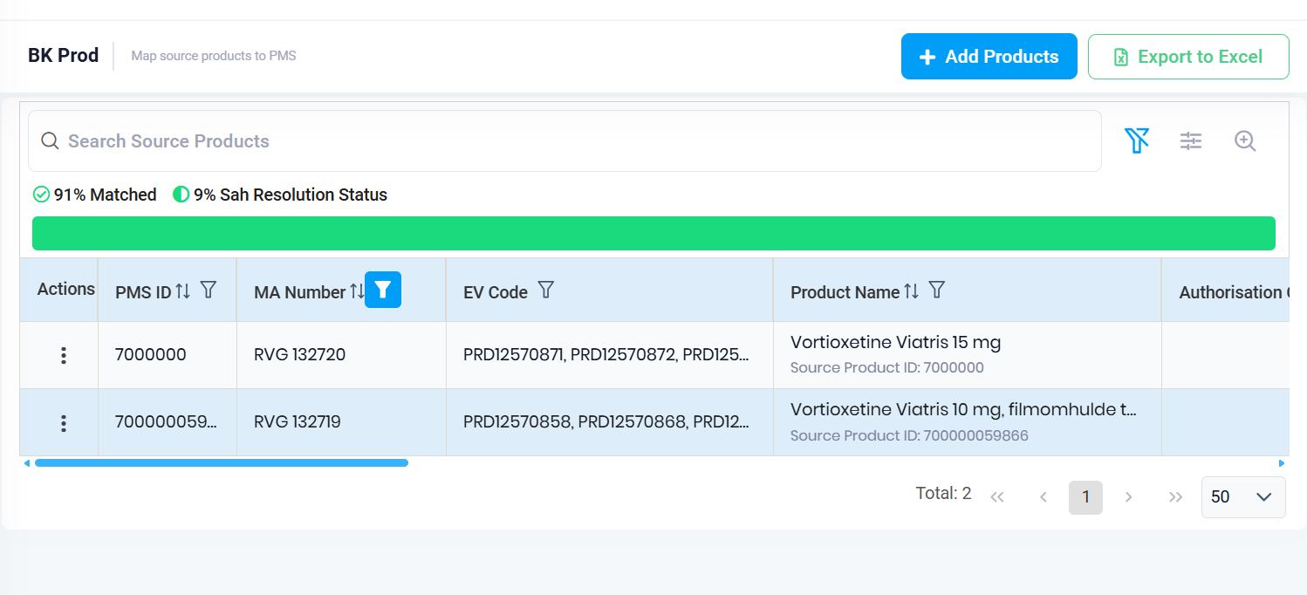
SPRFY-4651: Extend Product Module to Contain Source ID, Country, and MA Number: Source Products

Slide 10
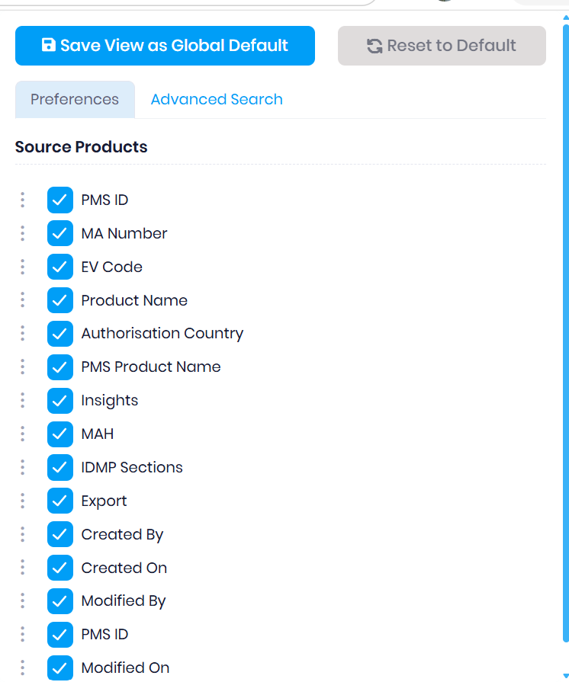
SPRFY-4651: Extend Product Module to Contain Source ID, Country, and MA Number: Source Products

Slide 11
Import Products via Excel

Slide 12
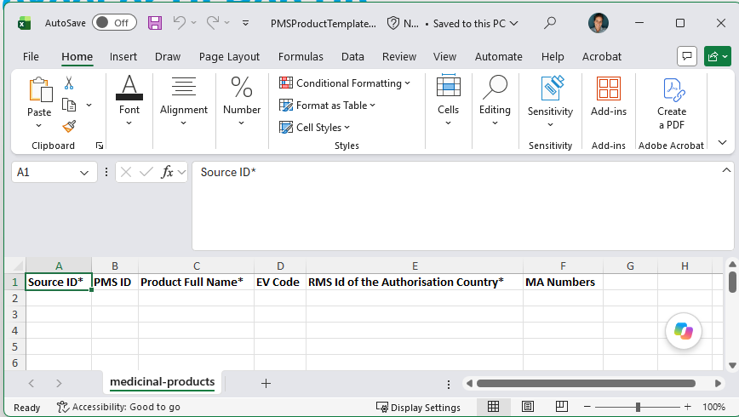
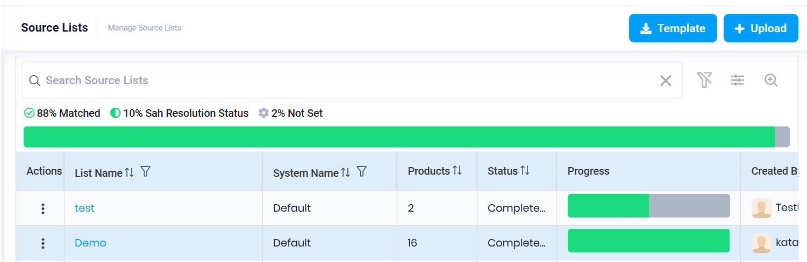
SPRFY-4881, SPRFY-4987, SPRFY-5060, SPRFY-5316: Upload Products via excel or UI Pop Up
Download the Template for the Product excel Import: Users can now download a pre-formatted Excel template for Product imports by clicking the Templates button located in the Products domain.

Slide 13
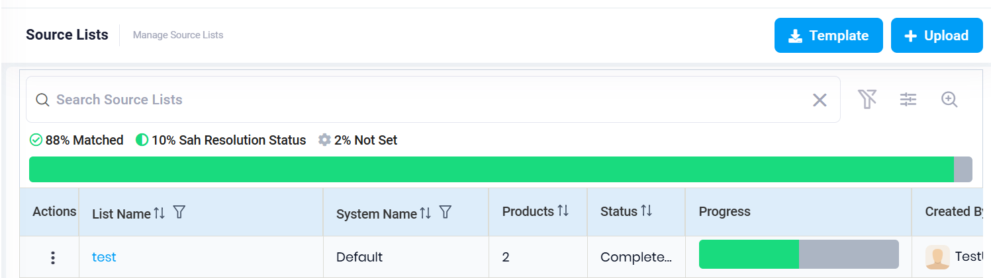
SPRFY-4881, SPRFY-4987, SPRFY-5060, SPRFY-5316: Upload Products via excel or UI Pop Up
Import Excel to Create Produc Source List: Users can now upload an Excel file to a Product Source List, in addition to the existing JSON and XML import options.
Add new Products to an existing Source List Via Excel: Users can now add new Products in bulk to an existing Source List by uploading an Excel file directly from within the list using the "Add Products" button.

Slide 14
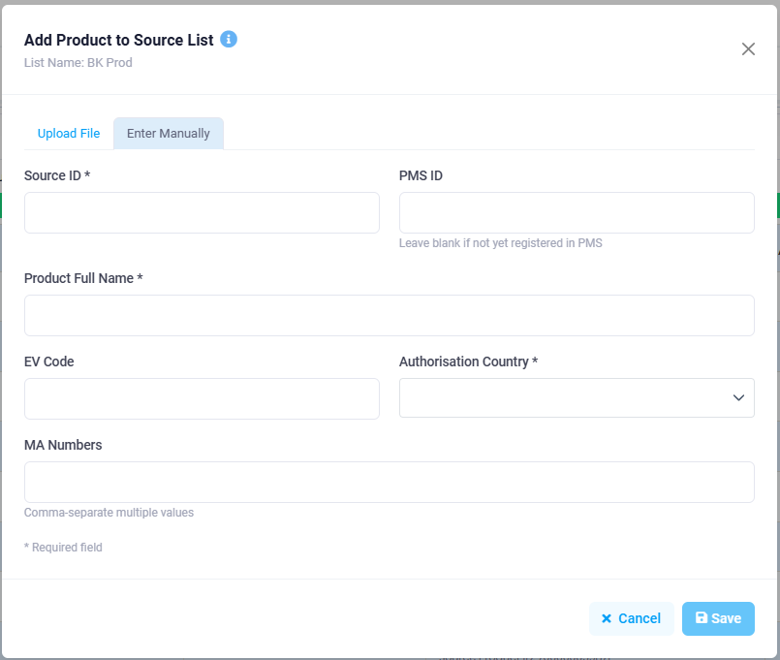
SPRFY-4881, SPRFY-4987, SPRFY-5060, SPRFY-5316: Upload Products via excel or UI Pop Up
Add One new Product to an existing Source list with a UI pop up:
Users can now add a new Product to an existing Source List directly via a convenient UI pop-up. This can be accessed by clicking the Add Products button, eliminating the need to process FHIR messages or upload an Excel template for single-Product additions. This enhancement streamlines the manual Product entry workflow.

Slide 15
SPRFY-4848: Avoid duplicate Products
Avoid Duplicate Products or Missing Required Fields:
The system now validates Products against existing Source IDs when users manually add a product, upload an Excel file, or submit FHIR messages to a Source List, preventing duplicate entries.
If duplicates are detected, an error message is displayed indicating the count and listings of the duplicate Source IDs.

Slide 16
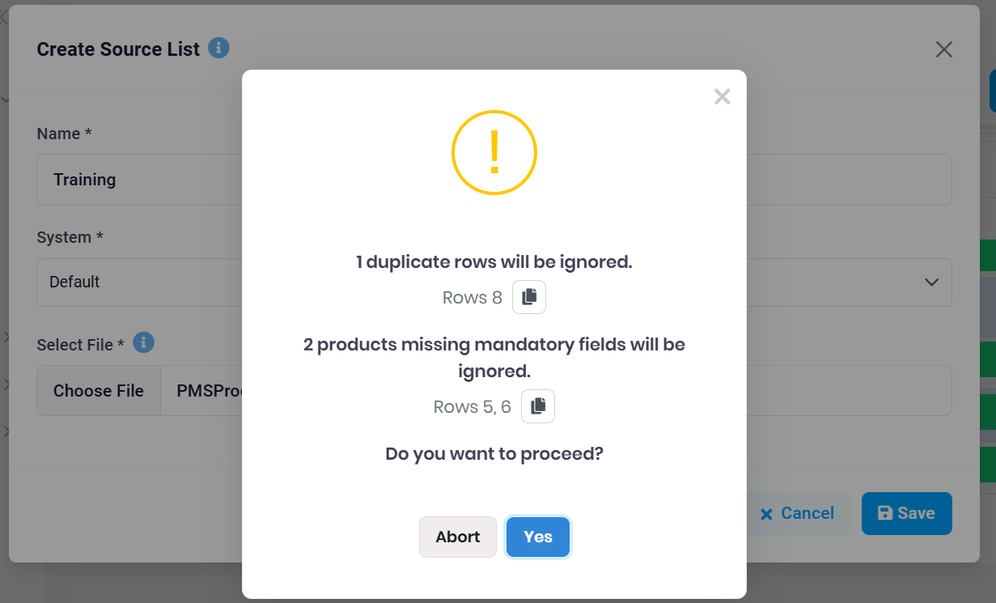
SPRFY-4848: Avoid duplicate Products, Update info box
Avoid Duplicate Products or Missing Required Fields:

Slide 17
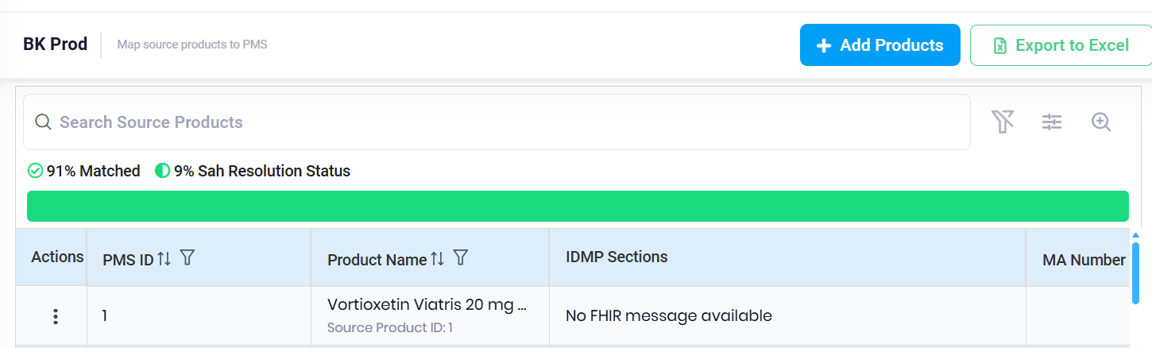
SPRFY-5371: Stop Comparison for Manual Product Creation
Stop comparison for manual product creation:
Products added to a source list via Excel upload or manual entry through the "Add Product" UI will now display a new comparison status of "No FHIR message available," clearly indicating that no actual FHIR message exists for these products and that an automatic comparison will not be triggered.

Slide 18
SPRFY-5317: Allow unlimited Number of Products to Upload
The previous limit of 500 Products per upload has been removed.
Users can now upload an unlimited number of Products via a single ZIP file (containing FHIR-format JSON or XML files), a single FHIR JSON/XML file, or an Excel template, with the only constraint being the maximum file upload size of 20 MB.

Slide 19
SPRFY-5491: Update info box to be in line with the functionalities
Update infobox to be in line with the functionalities:
The previously stated 500-file limitation has been removed, and the pop-ups now clearly indicate that users can upload a single ZIP file (up to 20 MB) containing individual FHIR files in JSON or XML format (one per Product), a single FHIR file in JSON or XML format (up to 20 MB) containing one Product, or an Excel file with multiple Products (up to 20 MB).

Slide 20
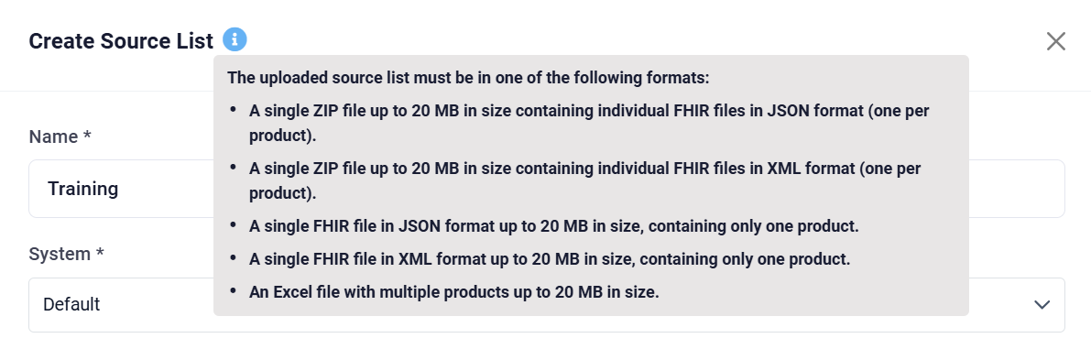
SPRFY-5491: Update info box to be in line with the functionalities
Update infobox to be in line with the functionalities:

Slide 21
SPRFY-5318: Enable Paralell upload of Files to the Same List
Users can now upload additional Product files to a source list while a matching or comparison process is already in progress, eliminating the previous blocking behaviour that prevented any interaction during processing.
While an upload is running, the actions menu and list navigation remain accessible, though the "Delete" option is appropriately disabled to protect data integrity. The Source List report has also been enhanced to display all product additions as individual entries — rather than only the last upload — with a new "Updated" date/time column (sorted newest first) so users can easily track when each batch of products was added.

Slide 22
MA Number Matching

Slide 23
SPRFY-4652, SPRFY-5020, SPRFY-5057, SPRFY-5058: Product matching on MA Number
Augment Product Matching with MA Number:
Product matching has been enhanced to support matching on MA. The system now follows an expanded mapping sequence — PMS ID, EV Code, MA Number, and Exact Name.
Split and Save MA Numbers:
SPORIFY newly supports the splitting and saving of Marketing Authorisation (MA) Numbers.

Slide 24
SPRFY-4652, SPRFY-5020, SPRFY-5057, SPRFY-5058: Product matching on MA Number
Multiple choice in case multiple match based on MA Number:
During mapping, when multiple Target Products are identified for a Source Product based on an MA Number, the system now presents the available options to the user for selection rather than performing an automatic direct mapping.
New Map type:
MA Number Mapping: Product mapping now supports the MA (Marketing Authorisation) Number as an additional map type.

Slide 25
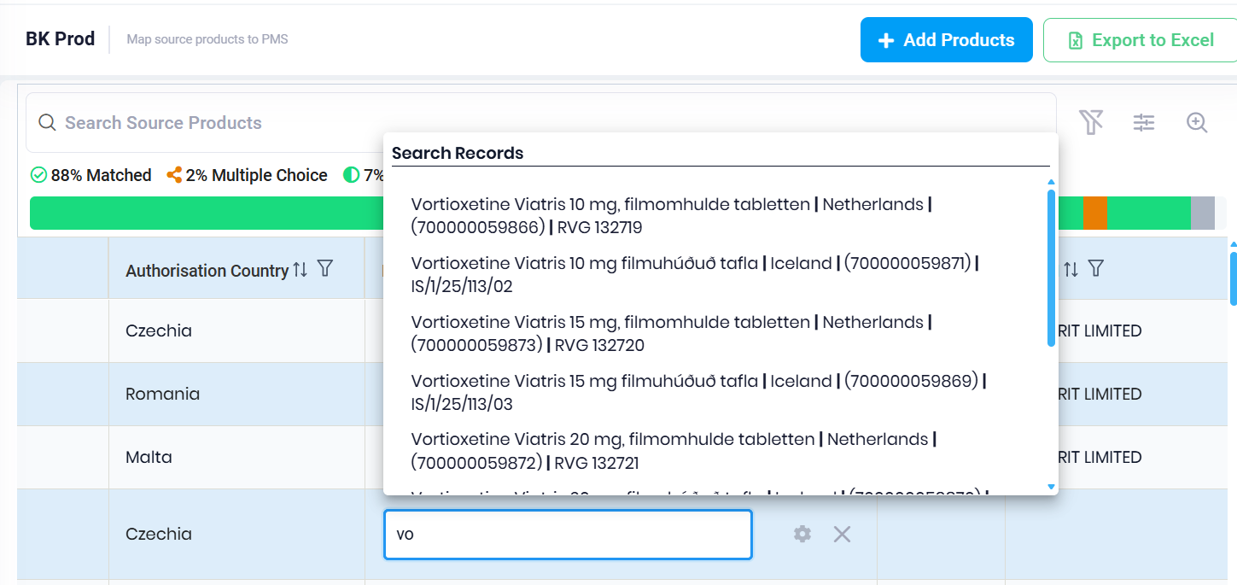
SPRFY-5022, More information on Matching
The Product matching view has been enhanced to display additional identifying details for each potential Product match, namely:
the Product Name
Country Short Name
PMS ID
MA Number.
This improvement helps users to easily identify potential Product matches and consequently make more informed matching decisions.

Slide 26
SPRFY-5023: Include country information on Name Matching
The Product Name matching functionality in SPORIFY has been enhanced to incorporate country information, ensuring that Products are matched to the correct country.
This improvement supports international pharmaceutical companies by reducing mismatches in multi-country Product registrations, delivering more precise and region-aware results.

Slide 27
Target Products

Slide 28
Extend Target Product Module

Slide 29
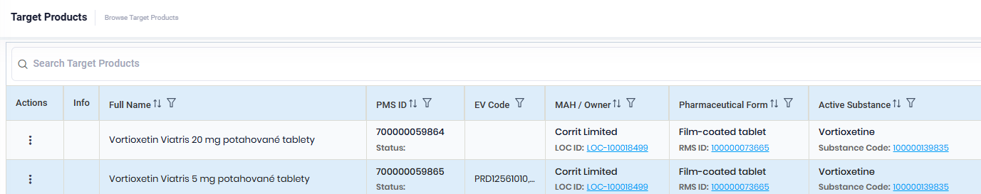
SPRFY-4889: Extend Product Target List With Existing Attributes
Change Description:
The Pharmaceutical Form column now includes an inline RMS ID, the MAH column displays an inline LOC ID and the Active Substance column shows an inline Substance Code with a hyperlink to the corresponding detail pages.

Slide 30
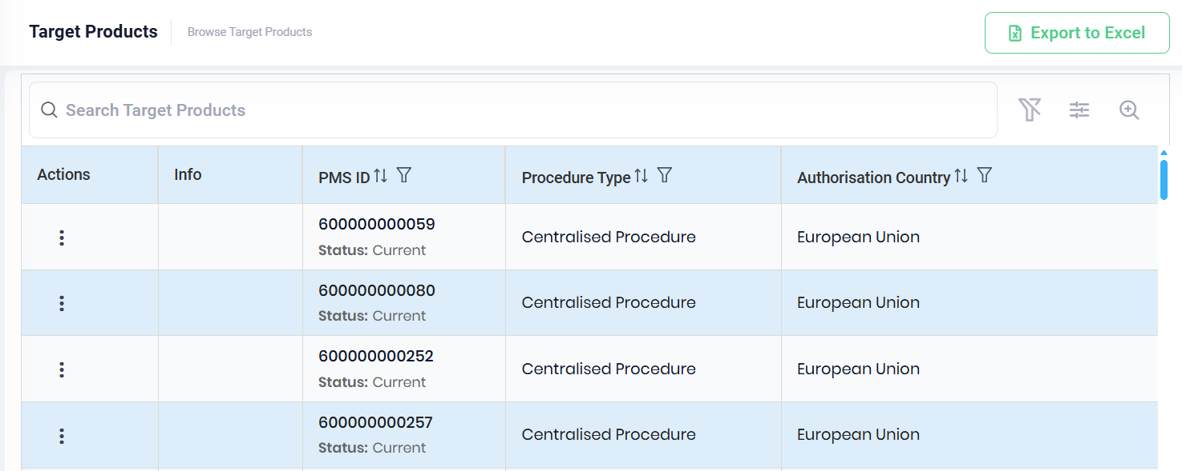
SPRFY-5052: Extend Product Target List With New Attributes
Change Description:
With this update, the Procedure Type and Record Status are now included in the Target List. The record status is in line with the PMS ID

Slide 31
SPRFY-5173: Procedure Type Column Should be Searchable/Filterable/Sortable and it Should Be Added to Preferences
In the Product module, users can now:
utilise the global search function for Procedure type.
filter products by Procedure type too. (the new table columns are sortable and filterable)
add or remove the new column via the Preferences fly-out menu.

Slide 32
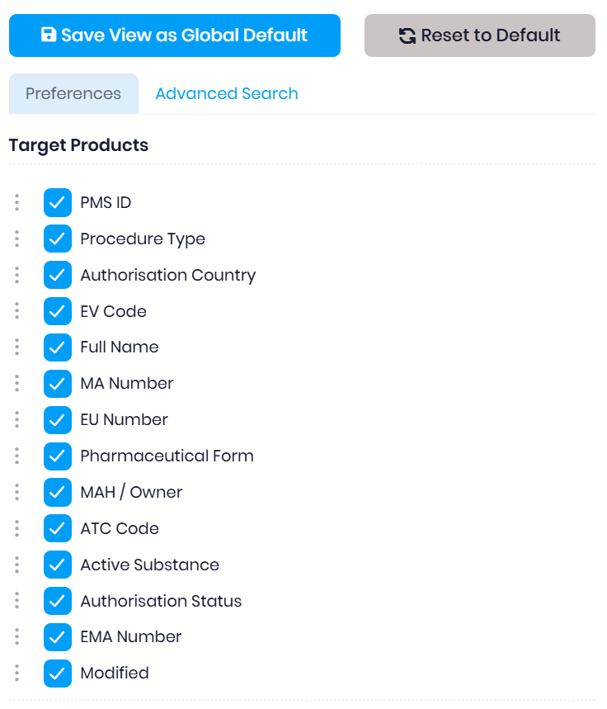
SPRFY-5173: Procedure Type Column Should be Searchable/Filterable/Sortable and it Should Be Added to Preferences

Slide 33
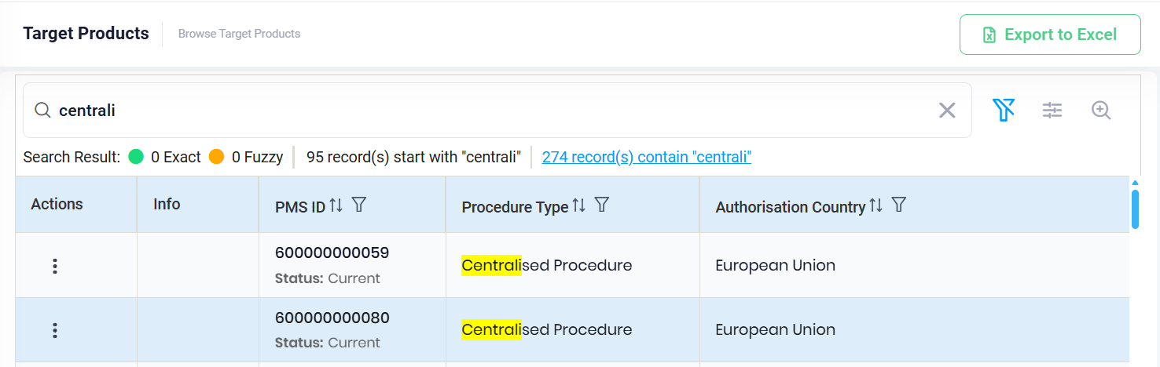
SPRFY-5173: Procedure Type Column Should be Searchable/Filterable/Sortable and it Should Be Added to Preferences

Slide 34
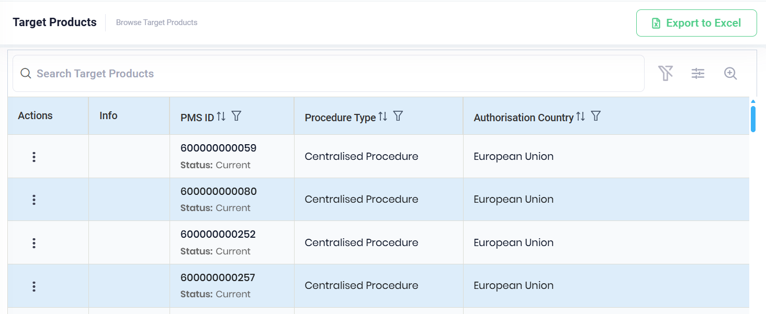
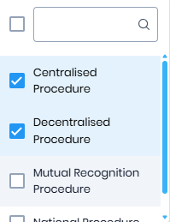
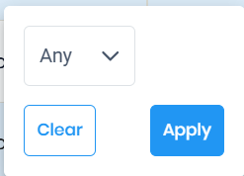
SPRFY-5173: Procedure Type Column Should be Searchable/Filterable/Sortable and it Should Be Added to Preferences

Slide 35
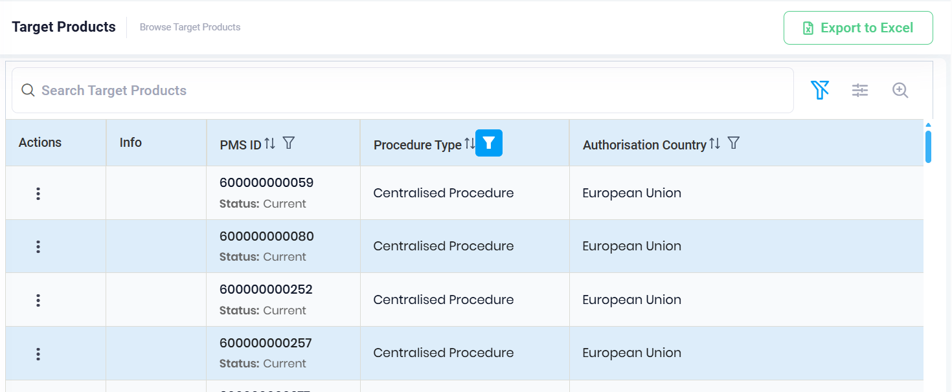
SPRFY-5173: Procedure Type Column Should be Searchable/Filterable/Sortable and it Should Be Added to Preferences

Slide 36
New Products insight

Slide 37
SPRFY-4874, SPRFY-4875: Insights into new Products
New ‚Unmapped Product’ Data insight for Target products:
A new 'Unmapped Product' data insight has been introduced for Target Products, enabling users to quickly identify Products that are not yet mapped to any Source List. The unmapped status is also included in the existing Target Product export alongside other data insights.
Filtering for the ‚Unapped Products Data Insight:
Users can now filter by the 'Unmapped Products' data insight within Preferences: Advanced Search.

Slide 38
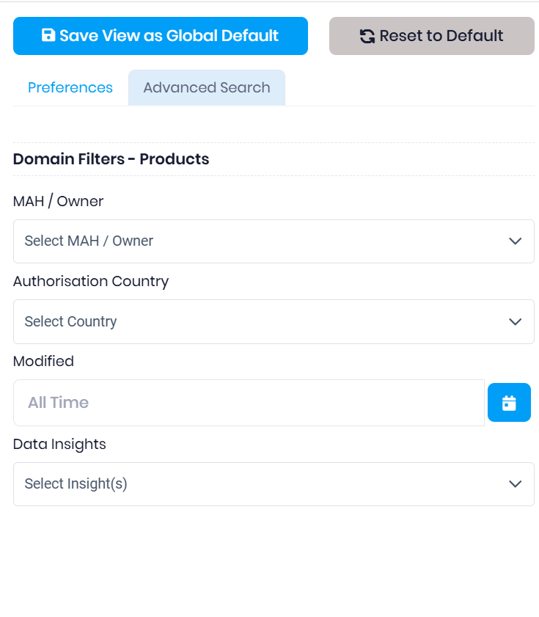
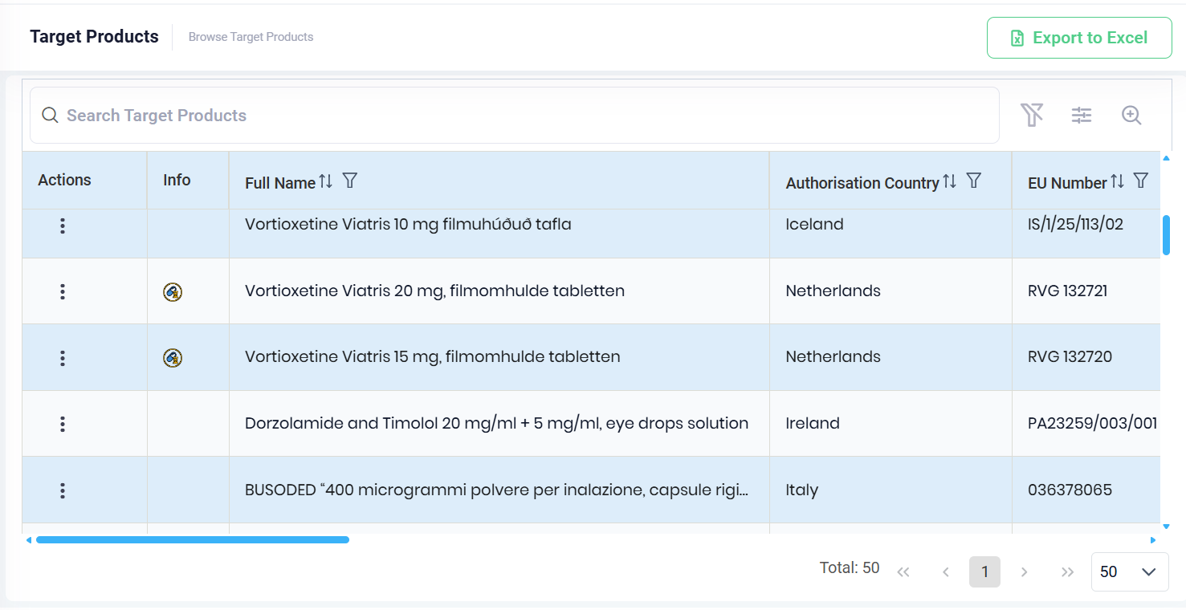
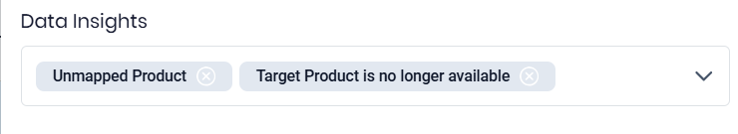
SPRFY-4874, SPRFY-4875: Insights into new Products

Slide 39
Remove IS, SI and NO Products from CAP records

Slide 40
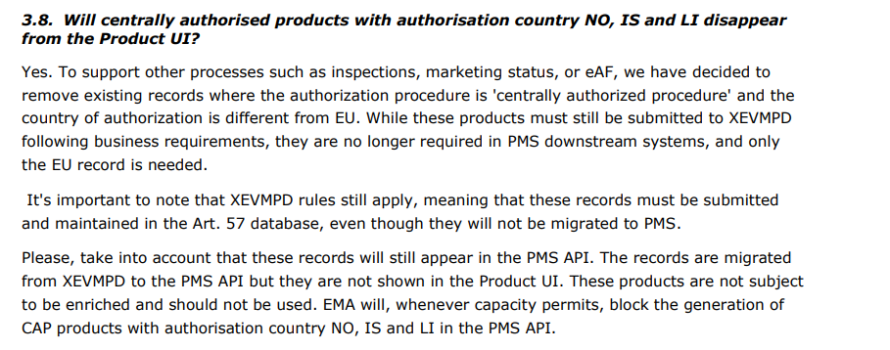
SPRFY-4821, SPRFY-5068: Remove IS, SI and NO records for CAP Products and block their sync
Background:
Centrally authorised Products associated with the authorisation countries Norway (NO), Iceland (IS), and Liechtenstein (LI) do not require enrichment as they are neither needed by PMS downstream systems nor displayed in the PLM UI. See: EMA FAQ:

Slide 41
SPRFY-4821, SPRFY-5068: Remove IS, SI and NO records for CAP Products and block their sync
Centrally authorised Products associated with the authorisation countries Norway (NO), Iceland (IS), and Liechtenstein (LI) are now excluded from the Target Product List during PMS synchronisation.
The already synced products will also be removed from the system. Additionally, any existing Source-to-Target Product mappings and comparisons linked to removed Target Products will be automatically wiped.

Slide 42
Integrations

Slide 43
Veeva sync

Slide 44
SPRFY-4680, SPRFY-4681, SPRFY-4682: Enrich Veeva with PMS ID
Create Veeva loader file: Based on the Veeva sync write configuration settings, if applicable the system automatically exports a Veeva loader file containing the matched PMS ID during each manual or scheduled sync.
Veeva sync write configuration: A new configuration option entitled ‘Enable Product Enrichment’ has been added to the system. When this configuration is enabled, Veeva users can opt to ‘Limit Matched Data Included in Sync By Resolution Status For Products’ and select a custom or default Resolution Status to which this setting should be applied.
Veeva sync detail log: Users can now download export files directly from the Sync Details section of the Veeva Log.

Slide 45
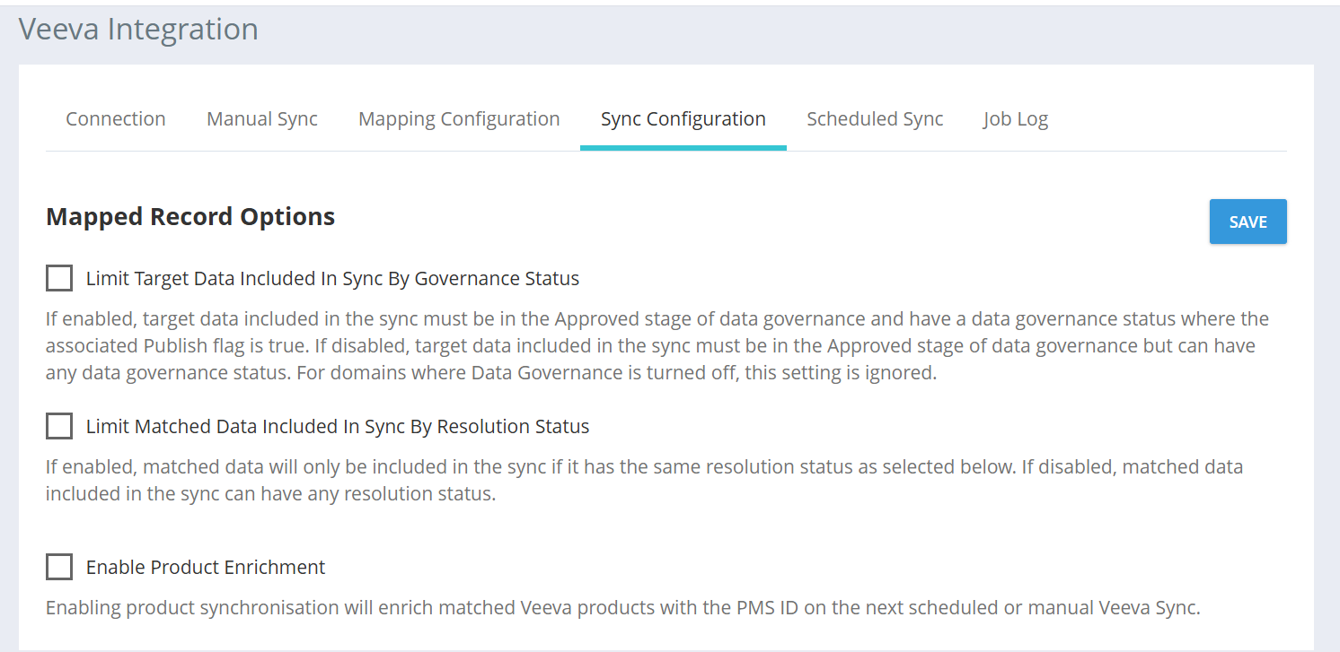
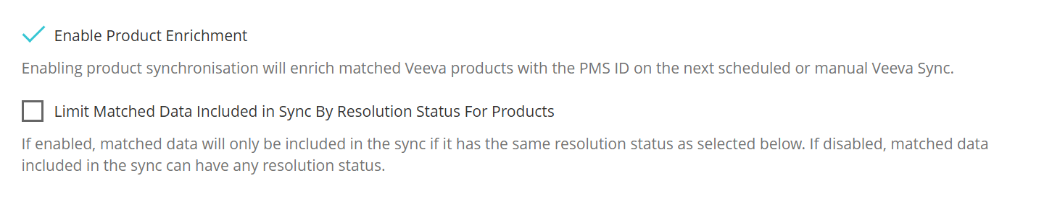
SPRFY-4680, SPRFY-4681, SPRFY-4682: Enrich Veeva with PMS ID
Veeva sync write configuration

Slide 46
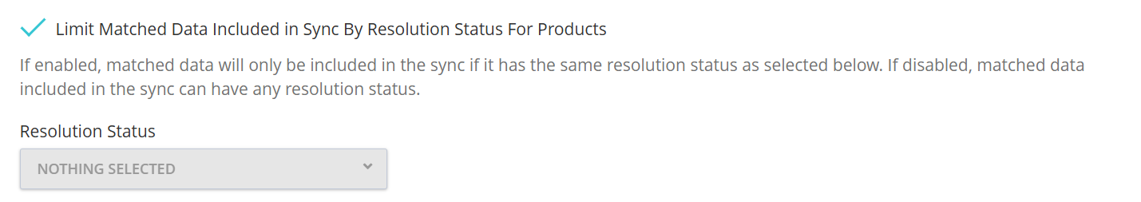
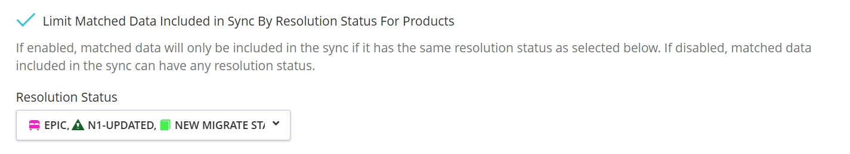
SPRFY-4680, SPRFY-4681, SPRFY-4682: Enrich Veeva with PMS ID
Veeva sync write configuration

Slide 47
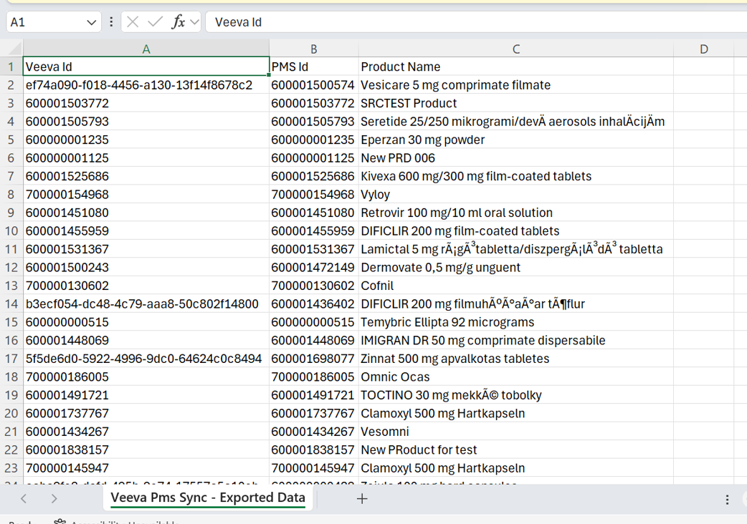
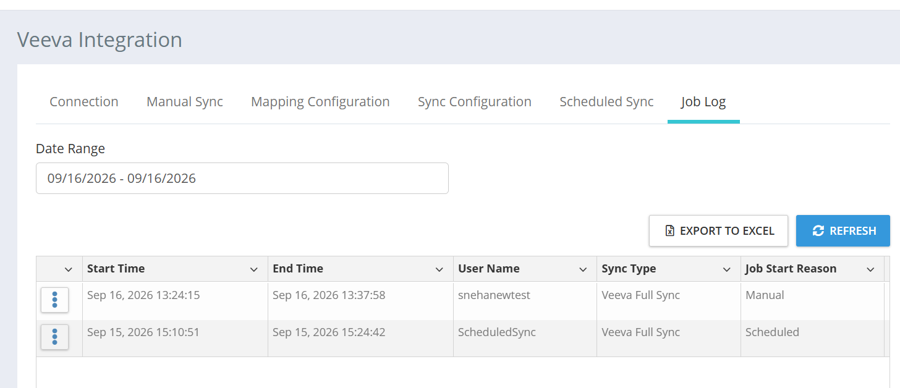
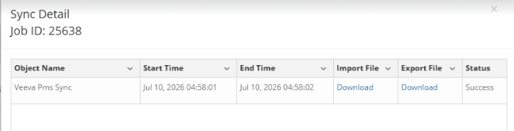
SPRFY-4680, SPRFY-4681, SPRFY-4682: Enrich Veeva with PMS ID
Veeva sync detail log

Slide 48
3rd party integration

Slide 49
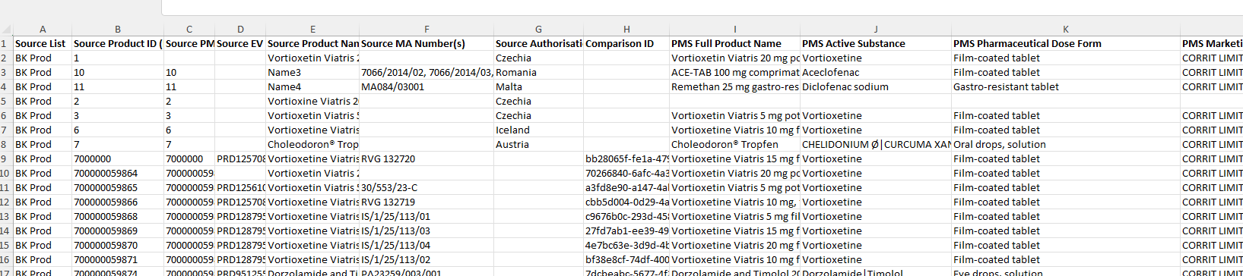
SPRFY-4854, SPRFY-4855, SPRFY-4685: Enable excel export ansd customer facing API for 3rd party integration
Export source Products as excel: Users can now export Products Source Lists as Excel files, making it easy for non-Veeva customers to extract the PMS IDs of matched Products and import them into their RIM system via files. The export captures all relevant Product information, including PMS IDs, and supports optional filtering to narrow down results before download.

Slide 50
SPRFY-4854, SPRFY-4855, SPRFY-4685: Enable excel export and customer facing API for 3rd party integration
Export source from API: A new API endpoint (/api/source/source-lists/{listId}/products) is now available, enabling integrated external systems to programmatically retrieve all Products from a completed Source List along with their matched PMS IDs in JSON format. The endpoint supports pagination (page sizes from 10 to 200) and filtering by Resolution Status, and is secured under the Products parent permission (covering Source, Target, and Compare Products).
Comparison report via API: A new API endpoint (/api/fhircomparison/{comparisonId}/export) that allows integrated systems to programmatically retrieve the Product Comparison Report has been introduced. The API returns the comparison results as an Excel file, enabling external systems to access and consume comparison data without relying on the SPORIFY UI. If the comparison ID is present but the comparison was not completed successfully, the API returns a ‘400 Bad Request’ response.

Slide 51
Product Comparison

Slide 52
SPRFY-4843: Filtering Comparison Statuses for Re-Running Purposes
Users can now filter comparisons by Status using Preferences: Advanced Search.
Multiple statuses can be selected simultaneously for filtering purposes if desired.
This enhancement allows data stewards to quickly isolate failed or other specific comparison statuses, making it easier to identify and re-run comparisons in bulk.

Slide 53
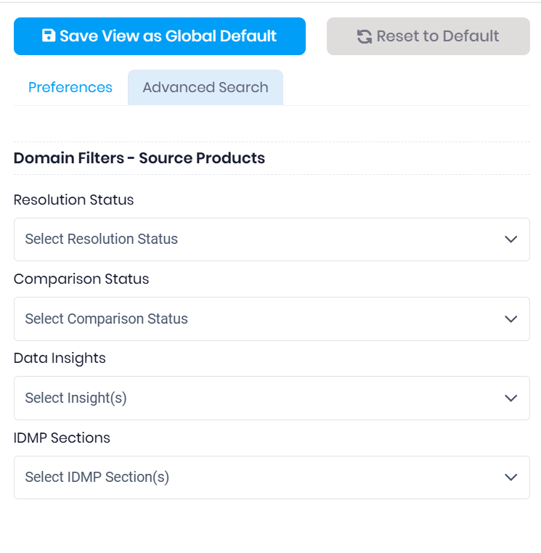
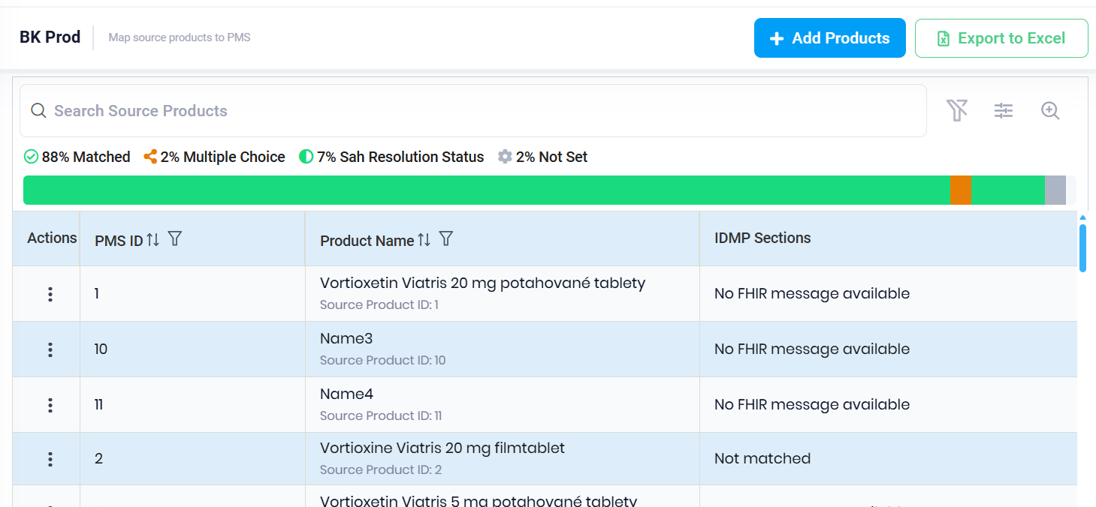
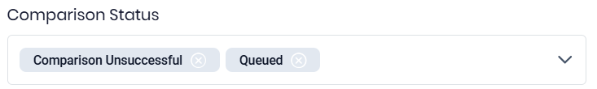
SPRFY-4843: Filtering Comparison Statuses for Re-Running Purposes

Slide 54
SPRFY-4844: Re-Running Comparison in Bulk
Data stewards can now re-run failed comparisons in bulk, eliminating the need to retry each one individually.
When at least one comparison fails, the user is given the option to ‘Rerun failed comparisons.’ This is particularly useful when a large upload fails because it allows users to quickly reprocess all affected comparisons in a single action, significantly reducing the manual effort required during error recovery.

Slide 55
SPRFY-4844: Re-Running Comparison in Bulk
Data stewards can now re-run failed comparisons in bulk, eliminating the need to retry each one individually.
When at least one comparison fails, the user is given the option to ‘Rerun failed comparisons.’ This is particularly useful when a large upload fails because it allows users to quickly reprocess all affected comparisons in a single action, significantly reducing the manual effort required during error recovery.

Slide 56
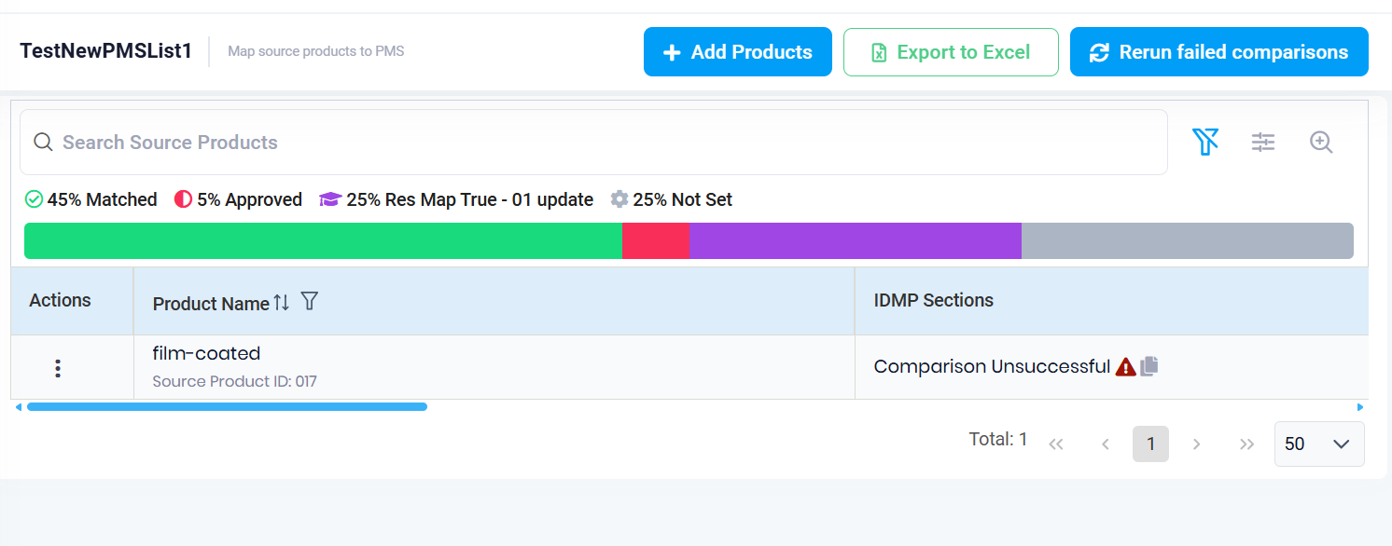
SPRFY-4844: Re-Running Comparison in Bulk

Slide 57
SPRFY-4847, SPRFY-5056: Show Comparator Error
Users can now view detailed error information for failed comparisons directly on the Source Products screen.
When a comparison fails, the relevant IDMP section displays a "Comparison Unsuccessful" status alongside an icon that reveals a user-friendly error message on hover, thus providing the failure reason immediately and eliminating the previous 24-hour waiting period.
For input-related errors, the specific reason is shown to the user, while internal errors display a unique Error Log ID that can be referenced when contacting support, enabling third-level support teams to trace the root cause.

Slide 58
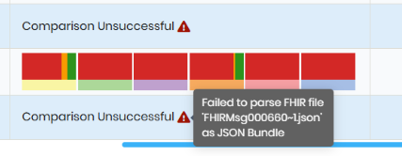
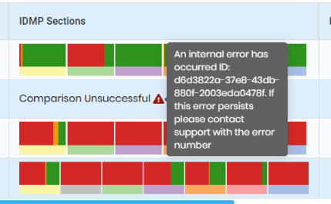
SPRFY-4847, SPRFY-5056: Show Comparator Error

Slide 59
SPRFY-4884: Improve Comparison Performance
The Product Comparison feature has been enhanced to deliver significantly faster results.
When comparing Products, users will now experience improved response times, ensuring comparison results are returned within seconds. This performance optimisation improves the overall usability and efficiency of the comparison workflow.

